Slide 1
networking

Slide 2
protocols
rules of communication

Slide 3
layers to network stack

Slide 4
https://en.wikipedia.org/wiki/OSI_model

Slide 5
packet switch network
every packet has a destination

Slide 6

HTTP
TCP
IP

Slide 7
http request anatomy
domains mapped to ip addresses
translated via dns routers

Slide 8
dig google.com
run that at the terminal

Slide 9
buying a domain name
google domains
or other places

Slide 10
whois
find out who owns a domain

Slide 11
http headers

Slide 12
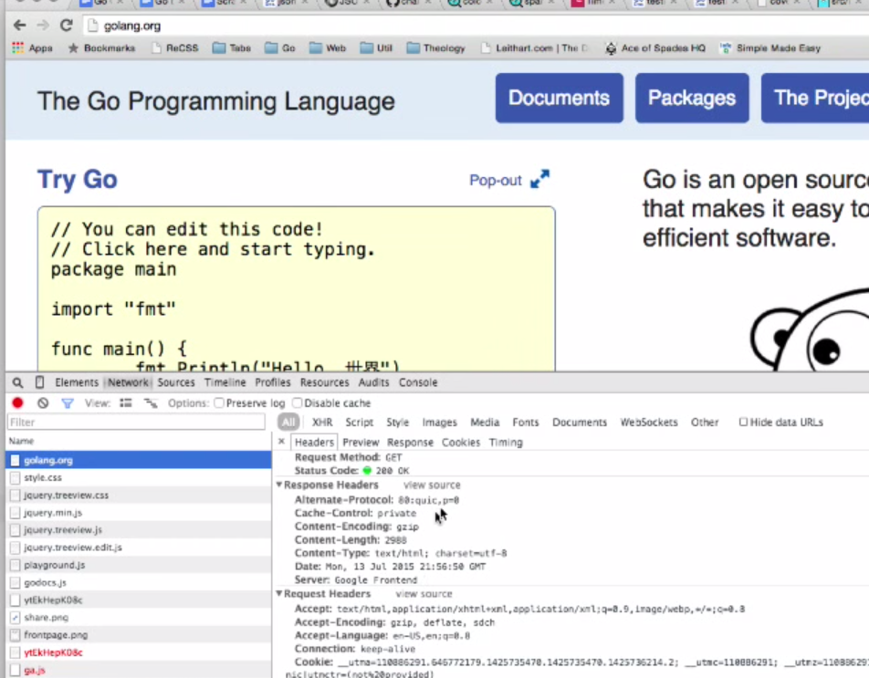

Slide 13
curl golang.org

Slide 14
curl -v golang.org

Slide 15
curl -I golang.org

Slide 16
http
tcp
tcp is the layer below http

Slide 17
tcp
tcp is the layer below http
tcp provides a reliable connection
puts packets in order

Slide 18
wireshark
software that shows you tcp activity

Slide 19
traceroute google.com
shows route to a website

Slide 20
distributed systems
we’re writing software today
that needs to run on distributed systems

Slide 21
distributed systems
client / server architecture
P-2-P architecture

Slide 22
server
IIS
Apache
database
load balancer / reverse proxy
clients

